Slide 1


Andy M. Méndez
30-Nov-2022

Slide 2

Outline
Executive Summary
Introduction
Methodology
Results
Conclusion
Appendix

Slide 3
Executive Summary
SUMMARY OF METHODOLOGIES
Data Collection
Data Wrangling
Exploratory Analysis using SQL
Exploratory Analysis using Pandas and Matplotlib
Interactive Visual Analytics with Folium lab
Interactive Visual Analytics with Ploty Dash
Predictive Analysis (Classification)
SUMMARY OF ALL RESULTS
Exploratory Analysis
Interactive Visual Analytics
Predictive Analytics

Slide 4
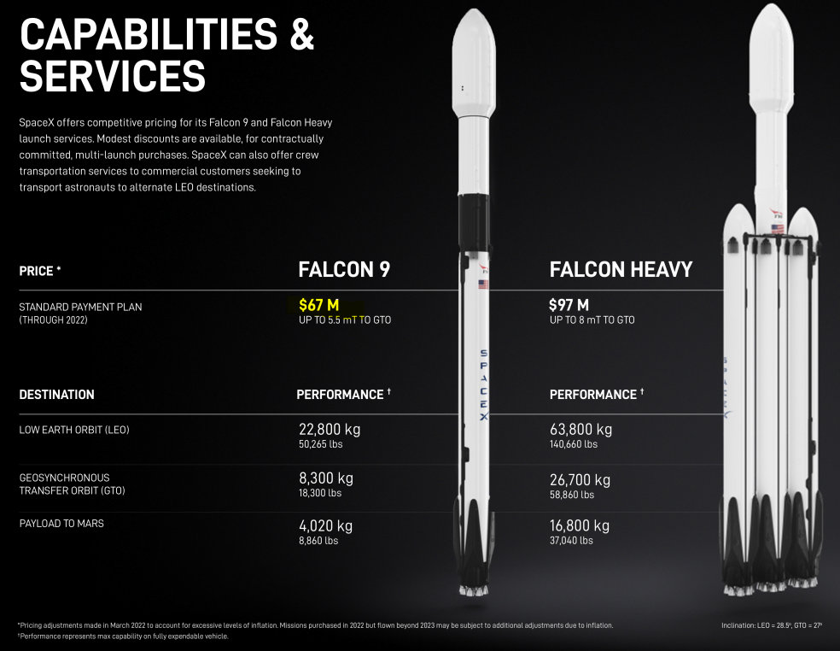
Introduction
Project background and context
SpaceX advertises Falcon 9 rocket launches cost 62 million dollars(pre-inflation); other providers cost upward of 165 million dollars each, much of the savings is because SpaceX can reuse the first stage.
Problems you want to find answers
In this project will predict if the Falcon 9 first stage will land successfully defining the accuracy of the landing.
https://www.spacex.com/vehicles/falcon-9/

Slide 5

Section 1

Slide 6
Methodology
Executive Summary
Data collection methodology:
SpaceX Rest API (“ spacex_url=https://api.spacexdata.com/v4/launches/past )
Web Scrapping
Perform data wrangling
The information collected incorporates data from both successful and unsuccessful launches, at this point the data is labeled prior to applying the machine learning models.
Perform exploratory data analysis (EDA) using visualization and SQL
Perform interactive visual analytics using Folium and Plotly Dash
Perform predictive analysis using classification models
Training and test data to find the best Hyperparameter for SVM, Classification Trees, and Logistic Regression.

Slide 7
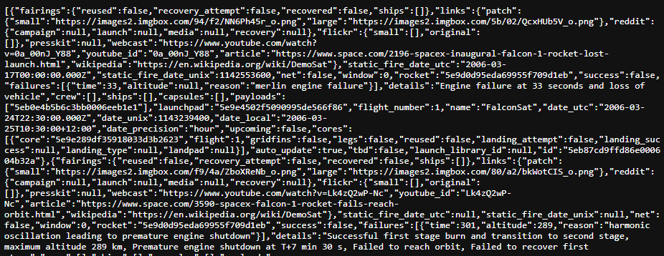
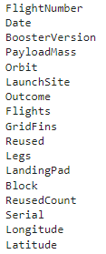
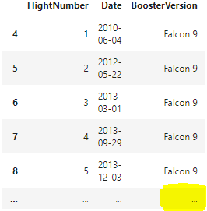
Data Collection
2. Pandas data frame
Describe how data sets were collected.
SpaceX launch data is collected from the REST API (https://api.spacexdata.com/v4/launches/past)
The REST API include enough information referring to:
1. API call
3. Filter the data to only include Falcon9
FlightNumber, Date, BoosterVersion, PayloadMass, Orbit, LaunchSite, Outcome, Flights, GridFins, Reused, Legs, LandingPad, Block, ReusedCount, Serial, Longitude, Latitude
4. Save to .csv

Slide 8
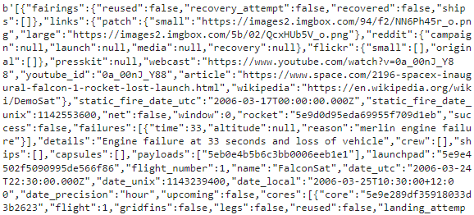
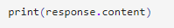
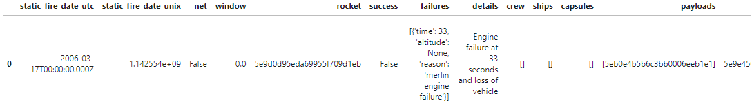
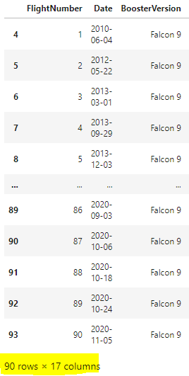
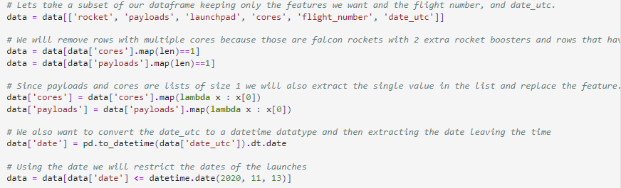
Data Collection – SpaceX API
2. Convert the .json() result into a dataframe
1. Data Collection
3. First Data Processing
4. Filter to only keep the features needed for Falcon 9 Launches
GitHub URL: https://github.com/AndyMik3/SpaceX_Project/blob/62f406d4d6ac4f466aa89e0fcafbe7c26f1e7bfa/jupyter-labs-spacex-data-collection-api%20(Lab1).ipynb

Slide 9
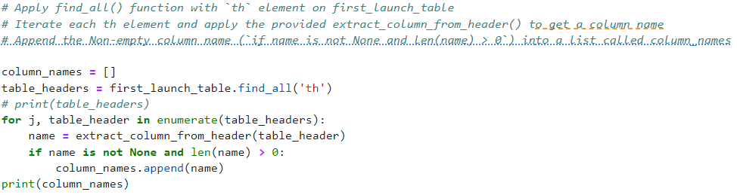
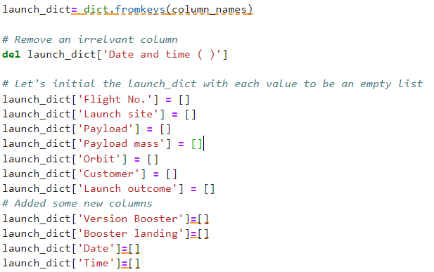
Data Collection - Scraping
1. Requests.get method
2. Create BeautifulSoup Object
3. Assign the result to a list (html_tables)
4. Get column names
5. Create an empty dictionary and convert into a Pandas dataframe
6. Export to CSV
GitHub URL: https://github.com/AndyMik3/SpaceX_Project/blob/07a1d8b5e3b5f29b1179559fc6b4a37b885a7582/jupyter-labs-webscraping(lab1.2).ipynb

Slide 10
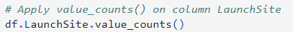
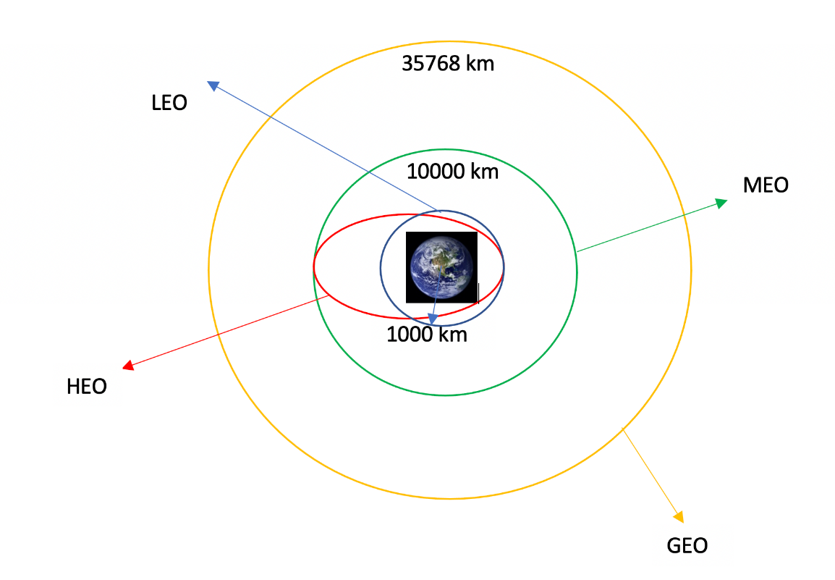
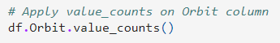
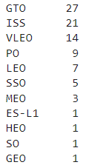
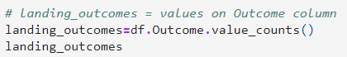
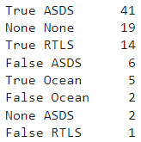
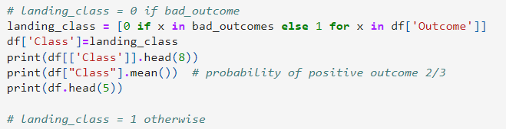
Data Wrangling
1. Calculate the number of launches on each site
2. Calculate the number and occurrence of each orbit
3. Calculate the number and occurrence of each orbit
4. Create a landing outcome label from outcome column
5. Export to CSV
GitHub URL: https://github.com/AndyMik3/SpaceX_Project/blob/07a1d8b5e3b5f29b1179559fc6b4a37b885a7582/labs-jupyter-spacex-data_wrangling_jupyterlite.jupyterlite%20(Lab2).ipynb

Slide 11
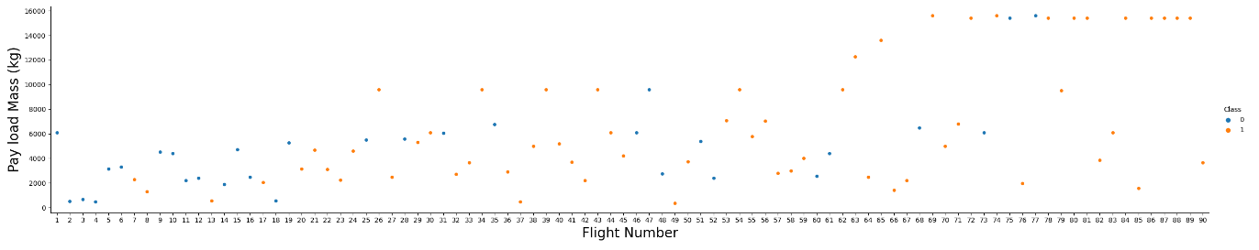
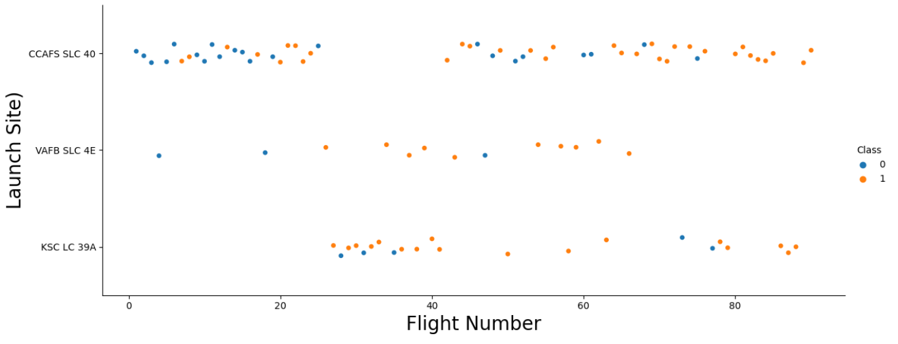
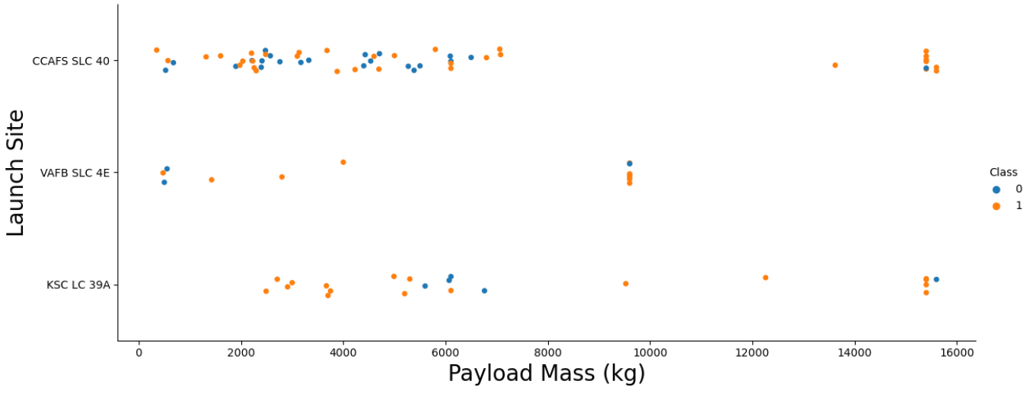
EDA with Data Visualization
According to the Flight numbers are increasing the Payload Mass (kg)
Relation between Flight number and Launch Site
Relation between Payload Mass and Launch Site
GitHub URL: https://github.com/AndyMik3/SpaceX_Project/blob/main/jupyter-labs-eda-dataviz.ipynb.jupyterlite(lab5).ipynb

Slide 12
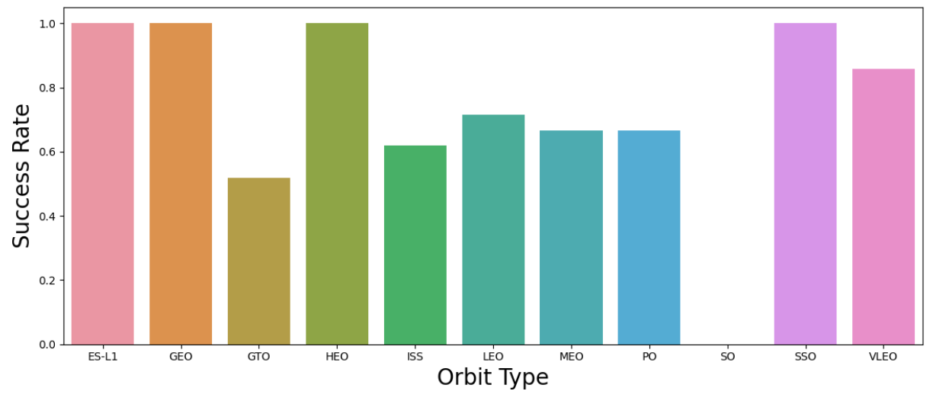
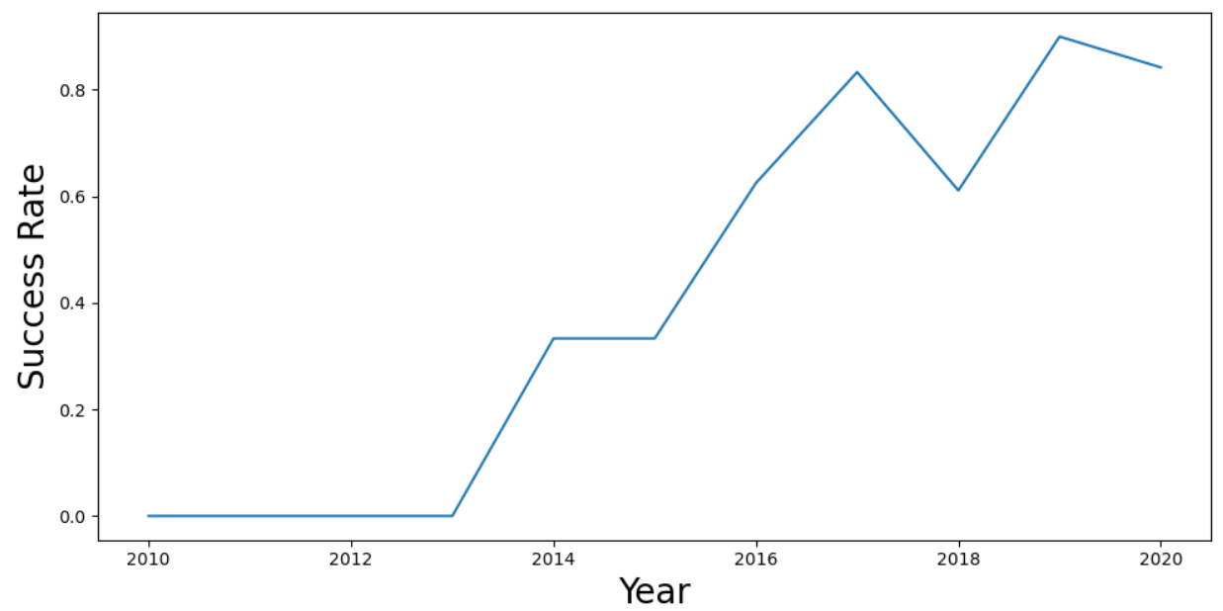
EDA with Data Visualization
Relation between Success Rate according to each orbit
Launch success yearly trend – increasing remarkably -
GitHub URL: https://github.com/AndyMik3/SpaceX_Project/blob/main/jupyter-labs-eda-dataviz.ipynb.jupyterlite(lab5).ipynb

Slide 13
EDA with SQL
Display the names of the unique launch sites in the space mission
Display 5 records where launch sites begin with the string 'CCA'
Display the total payload mass carried by boosters launched by NASA (CRS)
Display average payload mass carried by booster version F9 v1.1
List the date when the first successful landing outcome in ground pad was achieved.
List the names of the boosters which have success in drone ship and have payload mass greater than 4000 but less than 6000
List the total number of successful and failure mission outcomes
List the names of the booster versions which have carried the maximum payload mass. Use a subquery
List the records which will display the month names, failure landing outcomes in drone ship ,booster versions, launch site for the months in year 2015.
Rank the count of successful landing outcomes between the date 04-06-2010 and 20-03-2017 in descending order.
GitHub URL: https://github.com/AndyMik3/SpaceX_Project/blob/07a1d8b5e3b5f29b1179559fc6b4a37b885a7582/jupyter-labs-eda-sql-coursera_sqllite%20(lab4).ipynb

Slide 14
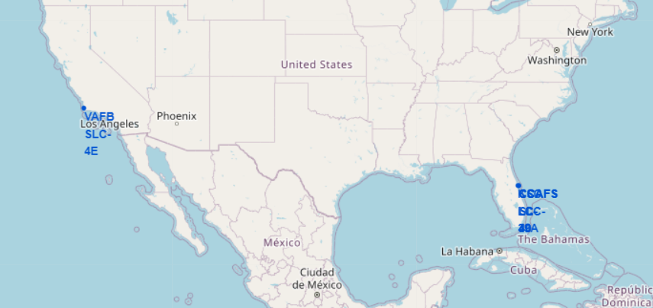
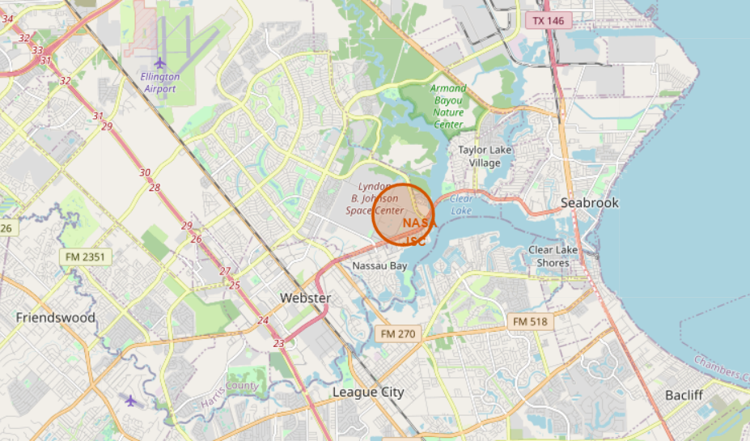
Build an Interactive Map with Folium
Blue circle at NASA Johnson Space Center's coordinate
Coordinate (Lat, Long) for a mouse over on the map
GitHub URL: https://github.com/AndyMik3/SpaceX_Project/blob/132fd31036d0e7176fa171082042dfccf7c60e80/IBM-DS0321EN-SkillsNetwork_labs_module_3_lab_jupyter_launch_site_location.jupyterlite.ipynb

Slide 15
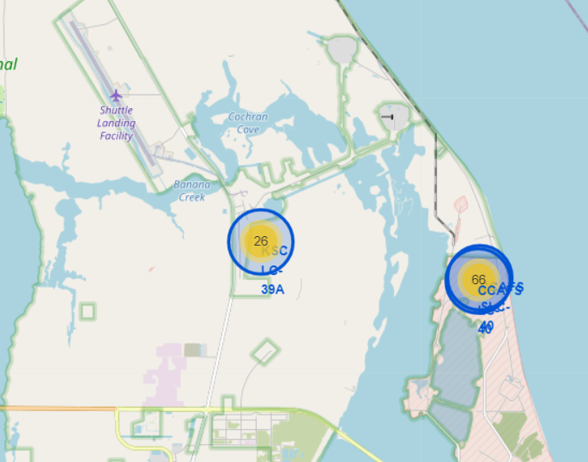
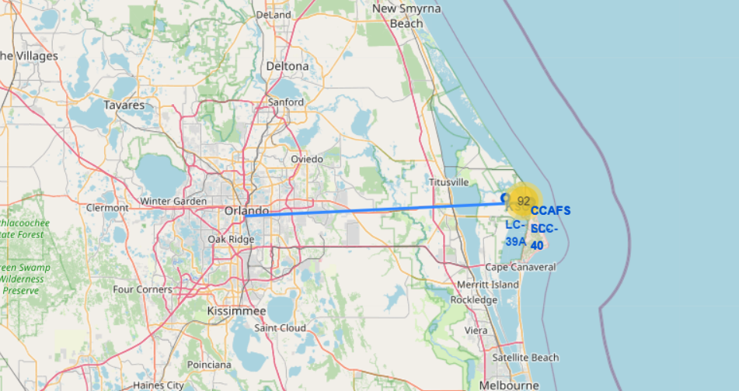
Build an Interactive Map with Folium
Marker with distance to a closest city.
(Line between the marker to the launch site)
`folium.PolyLine` object using the coastline coordinates and launch site coordinate
GitHub URL: https://github.com/AndyMik3/SpaceX_Project/blob/132fd31036d0e7176fa171082042dfccf7c60e80/IBM-DS0321EN-SkillsNetwork_labs_module_3_lab_jupyter_launch_site_location.jupyterlite.ipynb

Slide 16
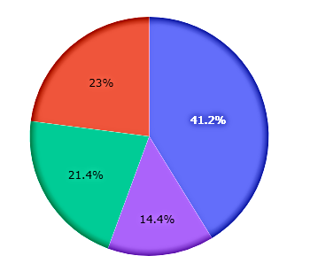
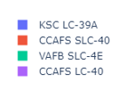
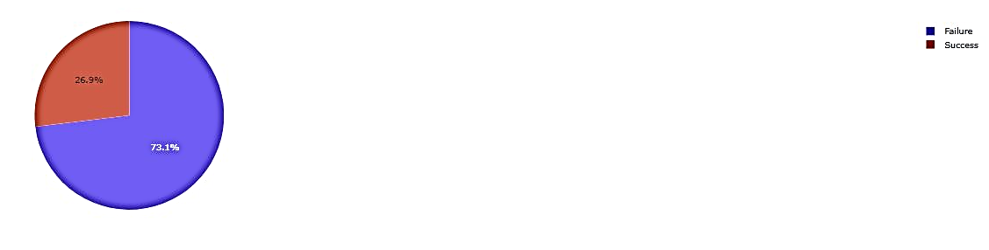
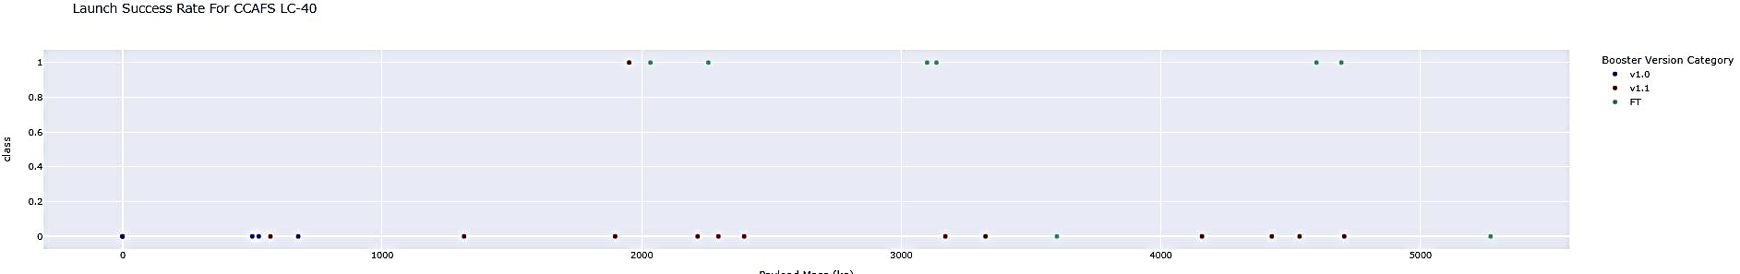
Build a Dashboard with Plotly Dash
SpaceX Launch Records Dashboard
Launch Success Rate For All Sites
Cape Canaveral Launch Complex 40 (CAFS LC-40)
Launch Success Rate for CCAFS LC-40
GitHub URL: https://github.com/AndyMik3/SpaceX_Project/blob/63c5adb8547e6636f40b86895e636509c1d57b77/jupyter-labs-eda-sql-coursera_sqllite%20(lab4).ipynb

Slide 17
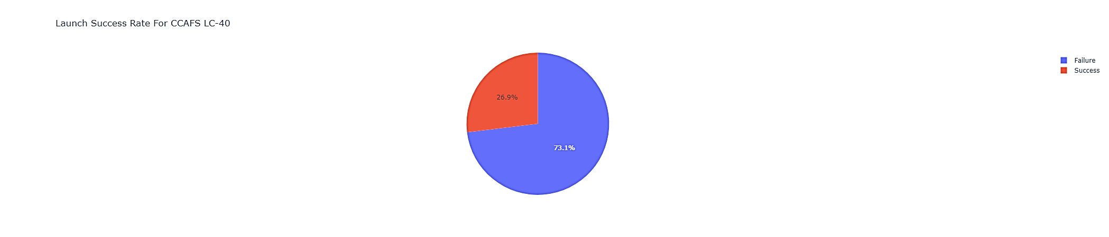
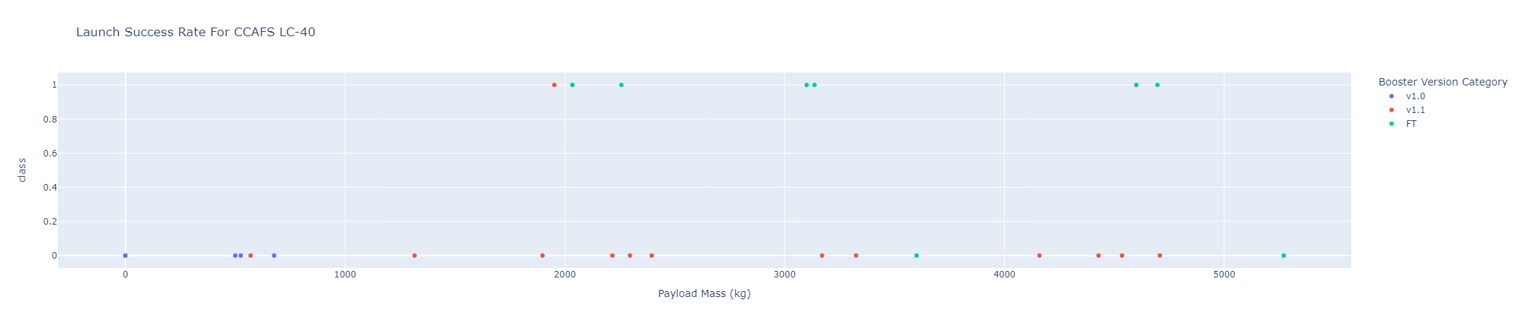
Build a Dashboard with Plotly Dash
GitHub URL: https://github.com/AndyMik3/SpaceX_Project/blob/63c5adb8547e6636f40b86895e636509c1d57b77/jupyter-labs-eda-sql-coursera_sqllite%20(lab4).ipynb

Slide 18
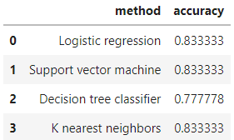
Predictive Analysis (Classification)
1. Create a column for the Class
2. Standardize the data
3. Split into training data and test data
4. Find best Hyperparameter for SVM, Classification Trees and Logistic Regression
5. Find the method that performs best using test data
GitHub URL: https://github.com/AndyMik3/SpaceX_Project/blob/63c5adb8547e6636f40b86895e636509c1d57b77/SpaceX_Machine_Learning_Prediction_Part_5.jupyterlite.ipynb

Slide 19
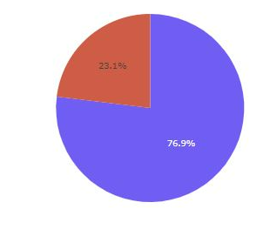
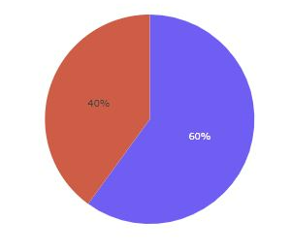
Results
The Support vector machine, logistic regression and K-nearest neighbors share the same value of accuracy
The success rate for KSC LC-39A was 76.9%
The success rate for VAFB SLC-4E was 60%

Slide 20

Section 2

Slide 21
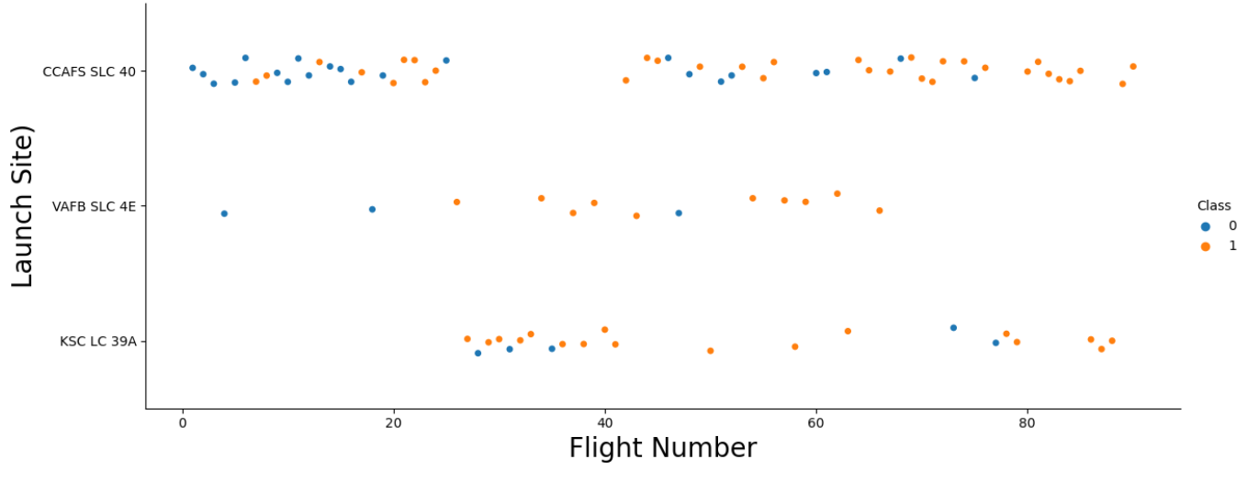
Flight Number vs. Launch Site
According to the flight number the CCAFS SLC 40 is notably the launch site most used

Slide 22
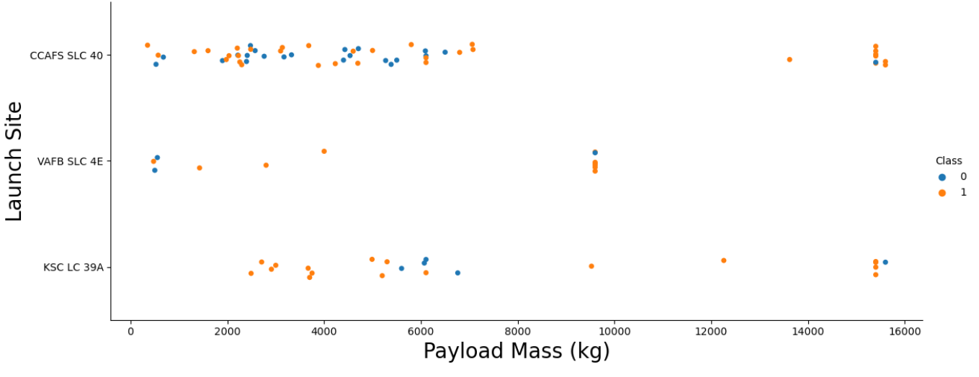
Payload vs. Launch Site
The payload mass is sent with a mass between 1000kg to 8000kg with few very specific launches close to 15000kg

Slide 23
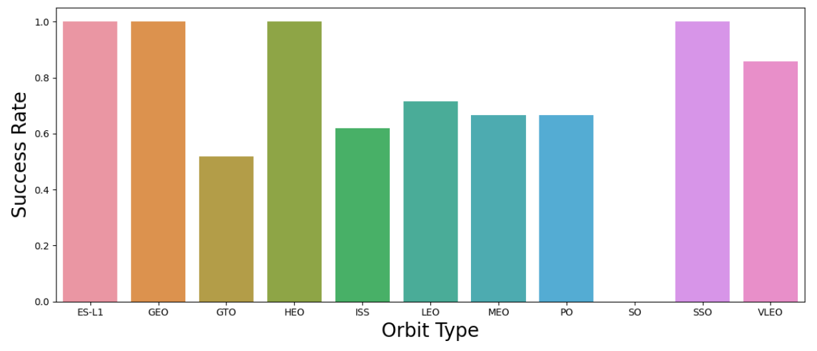
Success Rate vs. Orbit Type
High Success Rate for these launches
ES-L1
GEO
HEO
SSO

Slide 24
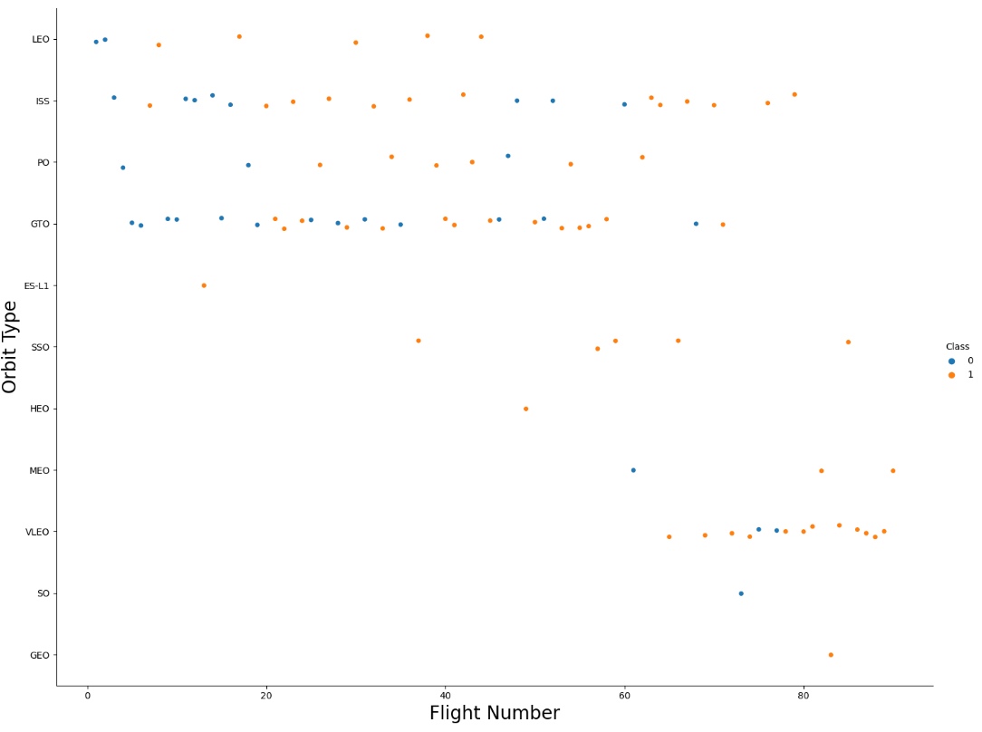
Flight Number vs. Orbit Type
The launches made initially were indistinct for LEO, ISS, PO, GTO orbits, as the number of flights increased, the range of the launch orbits also increased.
The last flights have been up to the VLEO orbit.

Slide 25
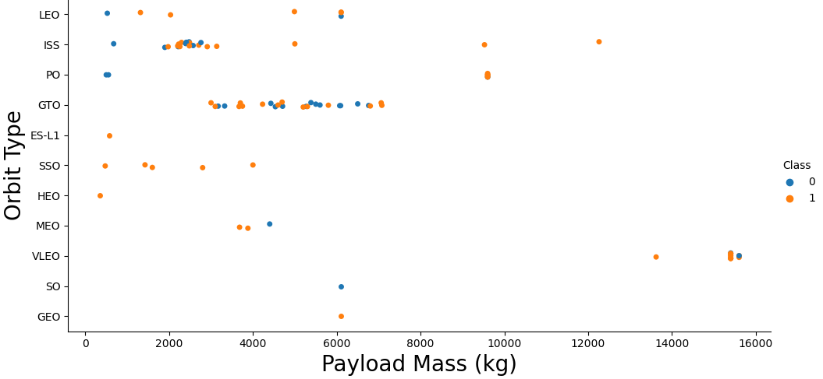
Payload vs. Orbit Type
The relationship between the payload mass and the launch orbit is clear.
When the payload mass is approximately 2000kg to 3000kg, the launch is to the ISS orbit.
When the payload mass is in a range between 3000kg to 7000kg the orbit is the GTO.

Slide 26
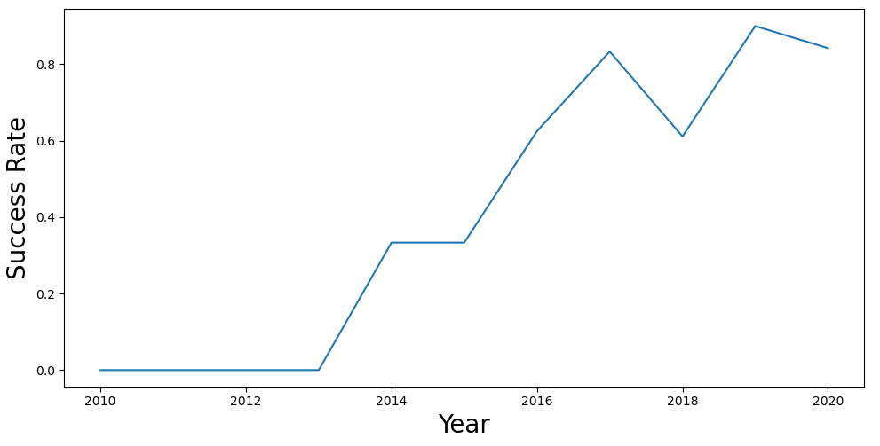
Launch Success Yearly Trend
The success rate has increased remarkably over the years.

Slide 27
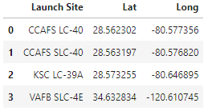
All Launch Site Names
Launch sites are presented with their latitude and longitude:

Slide 28
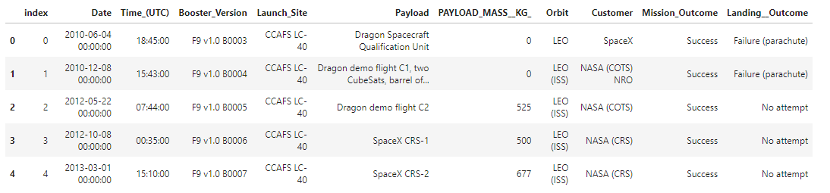
Launch Site Names Begin with 'CCA'

Slide 29
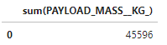
Total Payload Mass

Slide 30
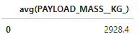
Average Payload Mass by F9 v1.1

Slide 31
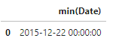
First Successful Ground Landing Date

Slide 32
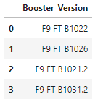
Successful Drone Ship Landing with Payload between 4000 and 6000
Boosters which have successfully landed on drone ship and had payload mass greater than 4000 but less than 6000

Slide 33
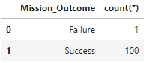
Total Number of Successful and Failure Mission Outcomes

Slide 34
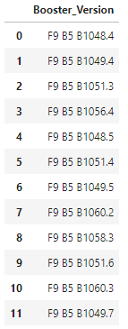
Boosters Carried Maximum Payload

Slide 35

2015 Launch Records
List of the failed landing_outcomes in drone ship, booster versions, and launch site names in year 2015

Slide 36

Rank Landing Outcomes Between 2010-06-04 and 2017-03-20
Rank of landing outcomes between 2010-06-04 and 2017-03-20 for:
Failure (drone ship)
Success (ground pad)

Slide 37

Section 3

Slide 38

SpaceX Launch Sites Locations (Folium map)
All the launch sites are near to the coast

Slide 39


Success and Failed launches
Successful launches are shown in green and failed launches in red.
In the visual map it is possible to zoom in on the study area to learn more about the launches made.
On the East coast there are bases with 26 and 66 pitches

Slide 40


Distance to proximities
The closest distances to different points of interest are presented with a line.
In the images the distance to the coastline is represented

Slide 41

Section 4

Slide 42

Launch Success Rate For All Sites

Slide 43

Success rate for the highest launch site
The Kennedy Space Center Launch Complex 39A
(KSC LC-39A) has a 76.9% success rate vs 23.1% rate of failure.

Slide 44

Payload Mass
Payload mass (kg) for launch success rate in all sites
There are a high number of launches when the payload mass is between 2k to 4k kg.

Slide 45

Section 5

Slide 46


Classification Accuracy
The logistic regression, Support vector machine and K-nearest neighbors share a high percentage of accuracy with 0.83

Slide 47
Conclusions
All the launch sites are near to the coastline for transport purposes and security
The Kennedy Space Center Launch Complex 39A (KSC LC-39A) has a 76.9% success rate vs 23.1% rate of failure.
The KSC LC-39A has the most success rate of all the launch sites.
The last flights have been up to the VLEO orbit.
The Support Vector Machine, Logistic Regression and K-nearest neighbors share the same value of accuracy equal to 0.84

Slide 48
Appendix
https://github.com/AndyMik3/SpaceX_Project.git

Slide 49


